Slide 2
Health Organizations Four Lenses

Slide 3

Personal Details
I am a Software Consultant, excited about technology for 30 years, 20 years professionally, 10 years in Health IT.
I work for Sierra Systems (an NTT DATA company), on contract with Quest Diagnostics, Health Canada, and BC Ministry of Health.
Although I am a consultant, I work for a product vendor (Quest), and I also work closely with government and other agencies like Ministry of Health, PHSA, VIHA…
I work with Health IT Solutions, and I also have expertise in other areas: Identity Management, Privacy & Security, Emerging Technologies, Web Development.
Notes:
I have worked at Sierra Systems with Health IT Solutions for about 10 years.
Talk about Health Canada work in Pharmacovigilance and MoH PRIME process

Slide 4
Health Organizations
Health – Wellness, Delivery of Care, Technology Platforms, Capacity, Patient Outcomes,
Organizations – Authorities, Public & Private Sector, Academia, Departments, Resources, Change Management, Providers, Consortia

Slide 5
Four Lenses into Informatics
Business – our industry is typically Public Sector Healthcare, and we also work with Private Sector Vendors.
Technical – Information Systems are necessary to operate at scale. Some of these are old, some are cutting edge.
Ethical – How can we create repeatable jurisdictional projects and processes?
Influence – We can convince ourselves, but are we also able to convince others?
Influence
Jurisdictional Ethics
Business
Technical
Notes:
Business Lens – why can’t public and private sector work together?
Technical Lens – Agile and OCM?
Ethical Lens – Three Ecologies

Slide 6
A Business LENS

Slide 7
ITCH 2019 Call for Papers
Information Technology and Communications in Health International conference run by University of Victoria
From Research to Practice: Improving Usability, Safety and Patient Outcomes with Health Information Technology.
“Greater interaction needed among industrial, governmental and academic partners.”
Why is collaboration between the healthcare industry, government, and academia so challenging? We see this, but why?
Notes:
I wanted to take a somewhat more academic approach, to interrogate why collaboration between government and industry, within the context of academic research, is such a challenge. Could better understanding this challenge allow us to work “better together” with government?

Slide 8
Systems of Survival
“A dialogue on the Moral Foundations of Commerce and Politics” (Jacobs 1992).
Jane Jacobs describes two ethical systems:
Guardian syndrome, evolved from hunter-gatherers. Respect for hierarchy, adherence to tradition and discipline, expectation of loyalty, dispensing largesse.
Commerce syndrome, evolved later with trading. Values initiative and innovation, competition, industry, and honesty; dissent for sake of task.
Notes:
Jane Jacobs was a renowned urban activist. In her book, she describes two different moral systems. I am attempting to demonstrate alignment between government with Jacobs’ guardian syndrome, and industry with her commerce syndrome. She describes incompatibility, breakdown when the two are mixed.
Conflicts occur, according to Jacobs, when the precepts appropriate to one syndrome are applied to the other. This always generates problems. Furthermore, it is inevitable that problematic intermixing of the syndromes will occur over time, resulting in what she refers to as monstrous moral hybrids.
My purpose and method are to draw on my own personal experience and some secondary sources to discuss some of the challenges faced by government and industry when they work together, with a specific focus on emerging and disruptive technologies, and academic research in health informatics.

Slide 9
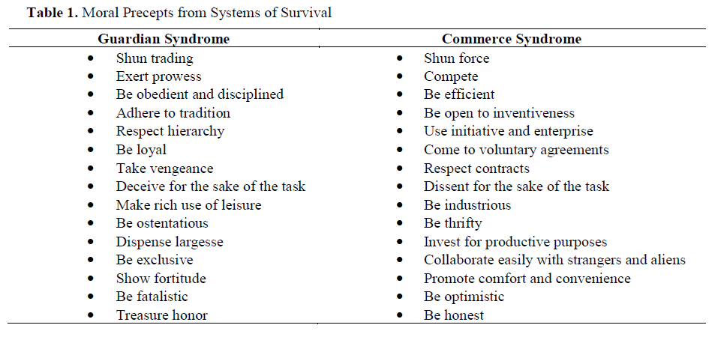
Systems of Survival
Notes:
On the left, you can see the sorts of precepts that guide government: build large things with large budgets, be ambitious, within a framework of hierarchy and discipline.
On the right, you can see the sorts of precepts the guide vendors: use innovation and invention to either increase profits or reduce losses, collaborate easily while still engaging in healthy competition.

Slide 10
Why is this so hard?
Government and the healthcare industry have radically different goals and operate using different moralities. They can work together, but it is hard.
Guardian: The role of government is to police, protect, and prevent. For instance, the cost of a privacy breach is not just financial, but loss of reputation.
Commerce: The role of industry is to focus on the bottom line – increase profit, reduce losses. This is accomplished through cost control and finding efficiencies.
If we look at emerging technologies, we should keep in mind how government and industry approach new approaches and platforms differently.
Notes:
I’m going to look at emerging technologies, and what I want to suggest is that these two systems of morality can be used a lens – how will government approach new technological approaches differently from vendors and healthcare industry development teams?

Slide 11
Example: Data, Privacy, and Siloes
Everyone has data, but… nobody wants to share it, so data needs to be protected in safe harbors, as part of Privacy by Design; but this same information only has value through use.
Data owners apply guardian precepts, relying heavily on hierarchy, rules, governance; deception for the sake of the task. “It’s not that I can’t do a DQA, but I can’t share the results…”
Data users apply commerce precepts, placing value on data through exchange, innovative use, invention and mashups… all to find efficiencies and value.
If data sources and a research community cannot see eye to eye, data is locked up in siloes.
Notes:
Quote from Stewart Brand: information wants to be free (information wants to have value). One of the reasons information ends up in solos is because different moralities cannot agree on the best approach forward.

Slide 12
Example: Enterprise Agility
Enterprise and Agile software development are like oil and water: they are very hard to mix, and so we end up with truly monstrous hybrids… Why is this, and what can we do about it?
Traditional enterprise architecture and waterfall exhibit signs of guardian syndrome. Rigid, expensive, formal, hierarchical, heavy emphasis on governance.
Agile development aligns with commerce syndrome. Collaboration and dissent are essential for task completion; innovation, efficiency, competition.
Mixing enterprise and agile approaches is a challenge, requiring both discipline and collaboration.
Notes:
Enterprise development methodologies like waterfall do not mix easily with agile software development because enterprise approaches are built around formality, whereas agile approaches are built around flexibility and efficiency.
I especially like the idea of dissent being essential for task completion. An agile Minimum Viable Product can remove scope when it becomes cumbersome or unnecessary. Dissent is a necessary part of reducing scope – do we need to do this? NO.

Slide 13
Practical Considerations
In Systems of Survival, Jane Jacobs provides some practical advice about ways we can, at least temporarily, bridge the gaps between guardian and commerce.
Caste Systems: these are limited by law and tradition to a single moral syndrome, keeping them separate. For instance, an auditor has access to a lot of data, but is prevented from profiting from this knowledge.
Knowledgeable Flexibility: ways in which people can switch between the two systems in a controlled way. As a consultant, I have been involved in writing RFP documents, and also building systems based on them.

Slide 14
Caste Systems
Groups or organizations that are limited by law and tradition to a single moral system.
To return to the auditor example, the auditor may be a member of a professional organization. I am a professional engineer, and I also have an affiliate membership with Canada Health Infoway.
You may hear people talks about “switching hats”. On any given day, I may be a standards guru, technical architect, business consultant, data geek, etc.
Joining a professional organization is useful for this and other reasons. Graduating from the HINF program also places you within a form of caste system.

Slide 15
Knowledgeable Flexibility
Ways in which people can switch between the two systems in a controlled way.
This is definitely true of a consulting role, and you will also experience this as a co-op.
On one project, you may work within an Operations group, and become highly averse to change.
On another project, you do technical development or quality assurance, and welcome change.
On another project, you may work for Data Services, and become resistant to sharing….
Notes:
The point is, every time you shift roles, you learn a new perspective

Slide 16
A Technical Lens

Slide 17
PLIS Project Overview: Where have we been?
PLIS is a centralized repository for Lab Information in British Columbia, developed by Quest Diagnostics.
It adheres to the Infoway Blueprint for a Jurisdictional Lab Information System, using JMS, SOAP, HL7v3.
A Lab Observation Report consist of Batteries, Cultures and Observations for:
General Chemistry (like bloodwork)
Microbiology (like cultures)
Anatomical Pathology (biopsy and autopsy)
Notes:
I have worked at Sierra Systems with Health IT Solutions for about 10 years.
Talk about Health Canada work in Pharmacovigilance and MoH PRIME process

Slide 18
PLIS Project Overview: Where have we been?
Primary Use The Primary Use case for PLIS is receiving and storing Lab Observation Report information and making this information accessible to clinical users.
Distribution Engine PLIS Primary Use also involves patterns for distribution of relevant information to partner organizations and points of service (EMR systems in doctors offices).
Results Reports PLIS Get results combine a machine-readable payload, using Battery and Observation level coding (LOINC), with human-readable PDF reports.
Secondary Use PLIS data has been province-wide for several years now, and work is underway to increase availability of active data through extraction to a data warehouse.
Notes:
I have worked at Sierra Systems with Health IT Solutions for about 10 years.
Talk about Health Canada work in Pharmacovigilance and MoH PRIME process

Slide 19
PLIS Project Overview: Emerging Technology
PLIS is a customized product development built on Java and Spring and is a decade old. We have a budget for maintenance and enhancements.
Java is not an emerging technology, but it is still a very viable way to build enterprise applications like registries and repositories.
Internally, we have introduced some new libraries to improve performance and functionality, with routine library upgrades.
This is quite common within an enterprise architecture. Back-end systems have a longer roadmap for changes, while portals and viewer applications may be more cutting edge and feature more agility.
Recently, we have been working on a FHIR API in addition to the HL7v3 architecture, which is very high value for PHSA and MoH.
Notes:
I have worked at Sierra Systems with Health IT Solutions for about 10 years.
Talk about Health Canada work in Pharmacovigilance and MoH PRIME process

Slide 20
PLIS Project Overview: Vendor Organizations
PLIS and HIAL was originally developed by a consortium of Sun Consulting, MedPlus, and CGI; early in the initial contract, Sun was acquired by Oracle, and MedPlus was acquired by Quest Diagnostics.
Sierra Systems was brought in by Quest Diagnostics to do customization, and was recently acquired by NTT DATA.
In 2020, the HIAL contract transitioned to MAXIMUS, and the PLIS contract became direct between Quest and MoH. CGI has consistently been responsible for Operations.
The Quest team participates in the Architect and Project Management Working Groups. We work closely with PHSA, and indirectly with the other Health Authorities.
Notes:
I’m also involved with various HL7 FHIR working groups

Slide 21
Delivery of Healthcare Services in Canada
In Canada, responsibility and funds for Healthcare Delivery and Services are passed down from the Federal Government to the Provinces.
In turn, responsibility and funds are passed down from the Provincial Ministries of Health to various Provincial Health Authorities.
Organizations like CIHI, PHAC, and Canada Health Infoway play roles at Federal and Provincial level.
Notes:
I’m also involved with various HL7 FHIR working groups

Slide 22


Healthcare
Telco / Media
Health Canada Health Products and Food Branch
Business Need |  | Solution |  | Outcomes
Transition to mandatory use of HL7 SPL XML for product monograph submissions for approval and publication of drug and health product information. |  | Integrated solution using Drupal for workflow and role management & TEI Publisher for conversion of product monograph and other regulatory review documents. |  | Smoothed transition from use of PDF to HL7 SPL product monographs Developed DHPP portal, providing an ontological basis for drugs and other health products in Canada Developed consumer mobile proof-of-concept
Our work at Health Canada will provide an underlying ontology for pharmacovigilance & AER (adverse event reporting) across Canada. In addition to pharmacovigilance and consumer mobile, we are also contributing to projects in biocides and cannabis inspection.
Notes:
If you are interested in getting more involved with our pursuits in the Healthcare domain, our National Health SIGs are a great place to start!

Slide 23

Agile Development Critical Success Factors
Traceability
Find a Product Owner or Sponsor
Establish Cadence
We use GitLab Wiki and Issue Boards, OpenAPI3.
Over the lifetime of a contract or project, this may be different people, but these people are essential for success. Their time is valuable!
Regular, short meetings, frequent demonstration of working software.
Notes:
If you want to get more involved with the ongoing discussion about Agile Development, our Agile DevOps Community would be a great place to start!

Slide 24
Canada Health Infoway
Infoway helps to improve the health of Canadians by working with partners to accelerate development, adoption and effective use of digital health solutions across Canada.
Through investment, Infoway helps deliver better quality and access to care and more efficient delivery of health services for patients and clinicians.
Established in 2001, Infoway is an independent, not-for-profit organization funded by the federal government.
“Infoway’s purpose is to realize the vision of healthier Canadians through innovative digital health solutions.”
Infoway is also responsible for providing high-level technical guidance and support for standards development.
Although Infoway’s focus has not changed, its role has evolved, from funding pan-Canadian ‘infostructure’ projects like iEHR, HIAL and PLIS, to providing clinician tools, to driving patient access to healthcare services.

Slide 25
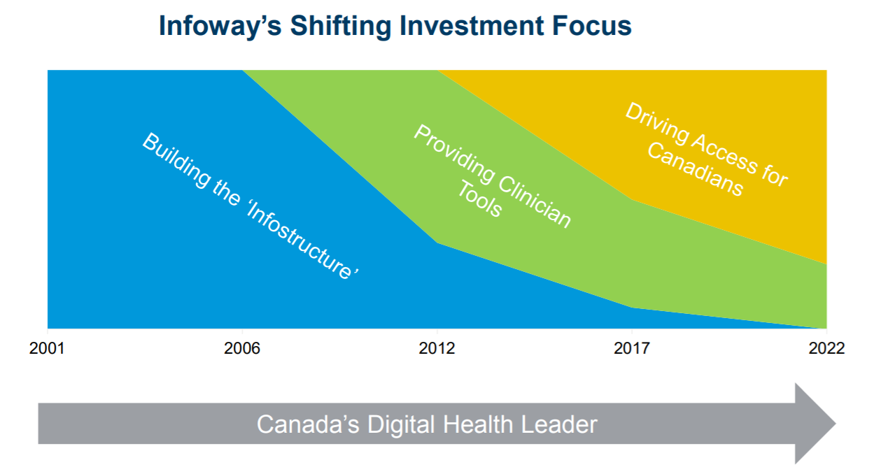
Canada Health Infoway

Slide 26
Pan-Canadian iEHR Landscape
The original 2005 Blueprint from Canada Health Infoway describes a jurisdictional approach to healthcare delivery, an architecture of foundational registries and repositories.
Client, Provider, User Registries are all intended to be HL7v3
Jurisdiction-wide assets for Provincial Labs, Rx, Diagnostic Imaging
HIAL is service bus + additional services
Point of service applications in Hospitals, Community and Practices.
About 5 years in, this Blueprint face a challenge when the U.S. opted away from HL7v3 adoption.
This posed a problem because Hospital systems are largely U.S. vendors, requiring a lot of adaptation and integration. This was why Quest partnered with Sierra.
Cerner, MEDITECH, Epic, AllScripts, McKesson.

Slide 27
An Ethical Lens

Slide 28
THREE “Ecologies”
Ecology 1: Objectivity/Materiality
What we typically consider as “ecology”, based in the material world.
Objects and relationships we can observe; tangibles, quantified.
Ecology 2: Subjectivity/Sociality
An ecology of the mind
Ecology 3: Prehension/Mediality
blah

Slide 29
Three “Ecologies”
Ecology 1: Objectivity/Materiality
What we typically consider as “ecology”.
Objects and relationships we can observe; tangibles, quantified.
Ecology 2: Subjectivity/Sociality
How do we interact with our environment (individual & society).
Ecology 3: Prehension/Mediality
How do we perceive ecology?
Mediation
Subjectivity
Objectivity

Slide 30
Accelerating adoption & benefits realization
Adoption is a process, not an end state
Benefits realization activities involve three core activities:
Articulation of the benefits;
Identification of key assumptions or conditions, and the development of action plans to address these; and
Measurement against objectives

Slide 31
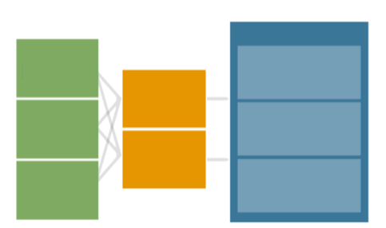


Canada Health Infoway benefits evaluation framework
Common scope of IT Projects
Net benefits
System quality
Clinicians engaged early and integrated into day-to-day processes
Value proposition
Systems approach
Achievable targets and benefits
Quality
Use
Information quality
Clinical Adoption
User satisfaction
Access
Service quality
Productivity

Slide 32
Impact of change management on adoption
Stakeholder Engagement
Sense of ownership of finished ‘product’ by users
Product that meets the needs of target users
Champions at all level
Workflow Analysis
System employs efficient practices and eliminates wasteful ones
Optimize patchwork processes that accumulated over time
Don’t automate bad processes!

Slide 33
Impact of change management on adoption (2)
Communication Planning & Delivery
Build excitement and anticipation
Set realistic expectations
Keep organization informed of progress
Reduce anxiety about change
Education & Training
Prepare users for new system
Support users during transition & ongoing
Obtain feedback of system use and functionality

Slide 34
Continuous quality improvement
Feedback loop – ensures continuous quality improvement
Lessons learned (process built into each project)
Project milestones and test points
Revise deliverables as projects evolve in order to accommodate internal/external changes
Technology
Data capture/data quality
Jurisdictional strategies

Slide 35
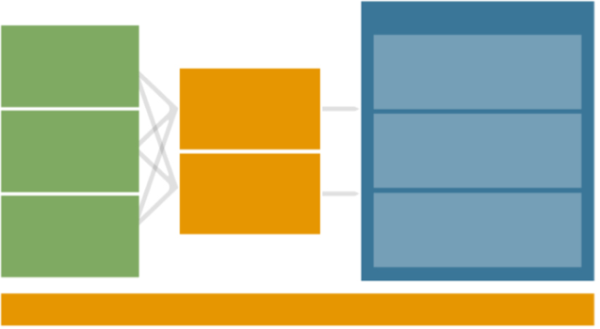
Canada Health Infoway benefits evaluation framework
Net benefits
System Quality
Functionality
Performance
Security
Quality
Patient safety
Appropriateness/effectiveness
Health outcomes
Access
Ability of patients/providers to access services
Patient & caregiver participation
Productivity
Efficiency
Care coordination
Net cost
Use
Use Behavior/Pattern
Self reported use
Intention to use
Information quality
Content
Availability
User satisfaction
Competency
User satisfaction
Ease of use
Service Quality
Responsiveness
ORGANIZATIONAL & CONTEXT FACTORS: STRATEGY, CULTURE & BUSINESS PROCESS – OUT OF SCOPE
Based on the Delone & McLean IS Success Model

Slide 36
4 critical questions
Are clinicians using the health information systems (HIS)?
Are they using it effectively?
Are they better able to provide quality patient care on the account of it?
Are the systems of benefit?

Slide 37

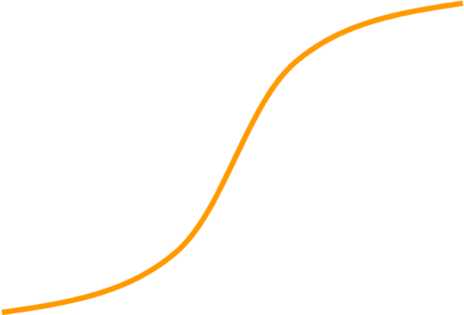
Maturity model – adoption & benefits curve
High
Richness of Adoption
Functionality, Integration.
Low
Low Breadth of Adoption High

Slide 38


Maturity model – the journey
High
Adoption is a process, not an end state
Clinical Transformation
Fully integrated
Advanced functionality
Data drives quality
Richness of Adoption
Functionality, Integration, etc.
improvement
Maximum Benefits
Occasional use
Not well integrated
Low functionality
Low measurement
and analysis capability
Low-hanging benefits
Low
Low Breadth of Adoption High

Slide 39



Maturity model – Stages of EHR adoption & expected benefits
High
Higher level benefits require targeted efforts for realization
Examples:
Productivity
Improved System Management
Knowledge Based Practice
Richness of Adoption
Functionality, Integration, etc.
Examples:
Coordination of Care across settings
Early patient safety benefits
Examples:
DI Film Costs
Filling information gaps
Low
Low Breadth of Adoption High

Slide 40



Maturity model – adoption measurement
High
Increasing sophistication of measurement helps drive maturity
Clinician driven focus on quality improvement
Richness of Adoption
Functionality, Integration, etc.
Surveys and check points are critical to understand quality and address drivers & barriers
Measurement is complex; start simple, but plan ahead and celebrate along the way
Measure active users – user and
access patterns combined. What are the measures of success?
Low
Low Breadth of Adoption High

Slide 41

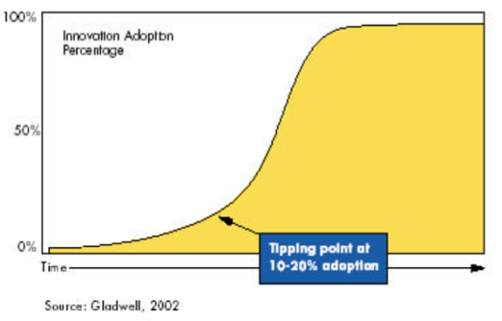

Adoption targets approach
Success 80%
Critical Mass 50%

Slide 42
Adoption target setting principles
Milestones based on adoption curve
Clearly articulated metrics
Comparable targets
Ongoing review and monitoring
Clear and consistent reimbursement structure

Slide 43
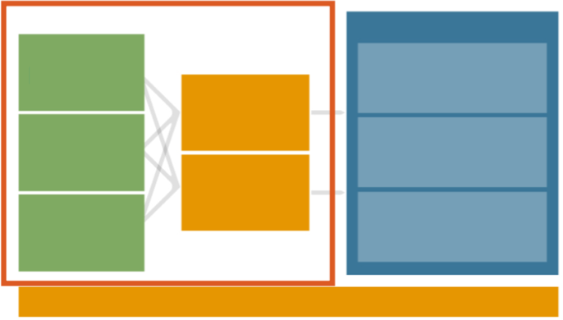

System use survey
Net benefits
System quality
Functionality
Performance Security
Quality
Assessment of user perceptions, drivers & barriers to change:
Diagnose and address adoption and benefits realization issues
Demonstrate early evidence of benefits
^{Patientsafey}
Appropriateness/effectiveness
Use
Use Behavior/Pattern
Self reported use Intention to use
Information quality
Content
Availability
Access
•
access services
User satisfaction
Competency
User satisfaction Ease of use
Service quality
Responsiveness
Care
coordination
Net cost
ORGANIZATIONAL & CONTEXT FACTORS: STRATEGY, CULTURE & BUSINESS PROCESS –
Based on the Delone & McLean IS Success Model

Slide 44
Reference guide and checklist
Guide ensures that three components of Clinical Adoption strategy (Change Management, Adoption, Benefits Evaluation) are addressed throughout stages of project life cycle
Project checklist outlines key steps in the process and provides project teams with guidance and quality assurance

Slide 45
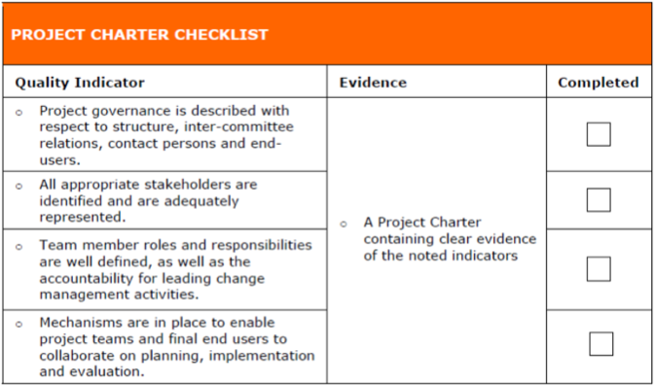
Example

Slide 46
In summary…points to note
Methodical planning up front and every step of the way.
Users and organizations progress along the adoption course in stages that require incremental change leadership and support.
Clear benefits and adoption targets must be aligned to each stage to allow users to understand the benefits.
Importance of having effective techniques to measure
adoption and user satisfaction against the objectives.
Celebrate!!

Slide 47
CPHIMS – 1 – Health Organizations and Workflow
Healthcare operations and workflow covers the processes and systems used to manage patient care and support clinical and administrative activities in healthcare organizations.
Healthcare delivery models: This includes an understanding of the different models of healthcare delivery, such as fee-for-service, value-based care, and accountable care organizations.
Healthcare operations management: This includes an understanding of the management of operations within a healthcare organization, such as managing patient flow, optimizing staffing, and managing resources.
Clinical workflow: This includes an understanding of the workflow and processes involved in patient care delivery, such as patient intake, diagnosis, treatment, and follow-up care.
Administrative workflow: This includes an understanding of the workflow and processes involved in administrative activities, such as scheduling, billing, and reimbursement.
Health information exchange: This includes an understanding of the processes and technologies used to exchange health information between healthcare organizations, such as health information exchanges and health information networks.
Healthcare analytics: This includes an understanding of the use of data and analytics to improve healthcare operations and patient care, such as predictive analytics, population health management, and quality improvement.
Healthcare quality and patient safety: This includes an understanding of the principles of healthcare quality and patient safety, such as quality improvement methodologies, patient safety practices, and regulatory requirements.

Slide 48
CPHIMS – 2 – Clinical Informatics
Clinical informatics is a specialized field of healthcare informatics that focuses on leveraging technology to support clinical care delivery and improve patient outcomes. From a CPHIMS (Certified Professional in Healthcare Information and Management Systems) perspective, clinical informatics involves the design, implementation, and optimization of clinical systems and workflows that facilitate the collection, analysis, and dissemination of clinical data.
Electronic Health Records (EHRs): The use of EHRs has become ubiquitous in healthcare, and a deep understanding of their design, implementation, and optimization is essential for clinical informaticians. CPHIMS candidates should be familiar with EHR workflows, data management, and the regulatory requirements governing EHRs.
Clinical Decision Support (CDS): CDS systems are used to help healthcare providers make more informed decisions by providing patient-specific information, clinical guidelines, and other decision-making tools. CPHIMS candidates should be familiar with the design and implementation of CDS systems, as well as the evaluation of their impact on clinical outcomes.
Clinical Analytics: Analytics can be used to identify patterns and trends in clinical data, which can be used to inform clinical decision-making, improve patient outcomes, and optimize clinical workflows. CPHIMS candidates should be familiar with the different types of clinical analytics (e.g., descriptive, predictive, prescriptive) and the various techniques used to analyze clinical data (e.g., machine learning, natural language processing).
Interoperability: Interoperability is essential for the seamless exchange of clinical data between different systems and providers. CPHIMS candidates should be familiar with the different standards and protocols used to achieve interoperability, as well as the challenges and opportunities associated with interoperability.
Clinical Informatics Governance: Clinical informatics governance involves the development and implementation of policies, procedures, and standards to ensure the effective and secure use of clinical informatics systems and data. CPHIMS candidates should be familiar with the key principles of clinical informatics governance, as well as the regulatory and compliance requirements governing the use of clinical informatics systems and data.

Slide 49
CPHIMS – 3 – Technology and Data Management
Technology and data management are critical components of healthcare information technology (HIT) and play a significant role in healthcare delivery. The Certified Professional in Healthcare Information and Management Systems (CPHIMS) certification exam covers several topics related to technology and data management in healthcare. Some of the key areas covered include:
Data management: This refers to the collection, storage, retrieval, and use of patient and clinical data in healthcare. CPHIMS candidates are expected to have knowledge of data warehousing, data mining, data quality, data integration, and data governance.
Health information exchange (HIE): This refers to the electronic exchange of patient health information among healthcare providers. CPHIMS candidates should have knowledge of the standards and protocols used in HIE, including Health Level Seven (HL7) and Fast Healthcare Interoperability Resources (FHIR).
Electronic health records (EHRs): CPHIMS candidates should have knowledge of EHR systems, including their design, implementation, and use. This includes topics such as clinical decision support, order entry systems, and user interfaces.
Clinical informatics: This refers to the use of information technology to support clinical decision making and improve patient outcomes. CPHIMS candidates should have knowledge of clinical informatics principles, including terminology and classification systems, clinical workflows, and the use of data analytics in clinical decision making.
Health information technology (HIT) infrastructure: This includes the hardware, software, and networking components that support the delivery of healthcare services. CPHIMS candidates should have knowledge of HIT infrastructure design, implementation, and maintenance, as well as security and privacy considerations.

